Slide 1
Visualisation for Data Science Introduction

Slide 2
Overview
This tutorial is laid out as follows:
In this tutorial, we will be giving you a high level overview of the content covered in the Visualisation for Data Science Digital Skill.
The main objective of this overview is to ensure that you have a good understanding of what is to come, how the digital skill is broken down, and what is in and out of scope for our upcoming learning. Let’s dive in!

Slide 3

Overview of Power BI
Using Data in Power BI
A Framework for Producing World-Class Visuals
Data Manipulation and Data Engineering in Power BI
Creating and Formatting Visuals in Power BI
Dashboarding Best Practise

Slide 4
Overview of Power BI
This section is a high-level overview of the business intelligence software, Power BI
Area Touched On
Brief Explanation
Installing Power BI
In this section, we will walk you through the installation process of Power BI step by step.
The basics of Power BI
After installing Power BI, we will go through some general features specific to Power BI. The aim here is to familiarise yourself with the software concepts.
Generating basic graphs in Power BI
From there, we will go into a guided basic example of connecting to a data source and generating a few basic visualisations.
Create calculated columns in Power BI
Finally, we will dive into simple examples of creating new columns, calculated columns and measures using DAX code.

Slide 5
Overview of Power BI
Using Data in Power BI
A Framework for Producing World-Class Visuals
Data Manipulation and Data Engineering in Power BI
Creating and Formatting Visuals in Power BI
Dashboarding Best Practise

Slide 6
Using Data in Power BI
This section is about loading data into Power BI and creating relationships between various data sources
In the context of
What do we do?
Loading Data Into Power BI
Loading Excel Data into Power BI
Here you will load different Excel files into Power BI and change the data types of the relevant features/columns.
1
Data Relationships in Power BI
An overview of different types of data relationships (cardinality) in Power BI, and how and where to access the relevant relationships between two tables.
2
Setting Up the Data Model in Power BI
Entity Relationship Diagrams in Power BI
Setting up a relationship between relevant features in the uploaded dataset by specifying cardinality and filtering direction.
3

Slide 7
Overview of Power BI
Using Data in Power BI
A Framework for Producing World-Class Visuals
Data Manipulation and Data Engineering in Power BI
Creating and Formatting Visuals in Power BI
Dashboarding Best Practise

Slide 8
C.I.N.D.Y Framework for Creating Visuals
In this section, we introduce you to C.I.N.D.Y - a framework that will guide you in creating efficient and effective visuals when working with different data types.
C.I.N.D.Y is an acronym for Categorical, Identifier, Numerical, Date and Geo-spatial (x-Y coordinates). These are some of the frequent data types that you will work with when creating BI dashboards. If applied correctly, this framework will simplify the creation of neat and clearly interpretable visualisations.
In introducing you to the C.I.N.D.Y framework, we will deep dive into the following:
What type of plots should be used for categorical data?
Best practise when plotting categorical data.
Things to keep in mind when plotting categorical data.
Use cases for categorical data.
Introduction to histogram plots when using numerical data.
Interpreting a histogram when using numerical data.
Effects of outliers on histogram plot.
Introduction to Box plots when using numerical data.
The 5 number summary of box plots.
Best practices when working with date data types.

Slide 9
Overview of Power BI
Using Data in Power BI
A Framework for Producing World-Class Visuals
Data Manipulation and Data Engineering in Power BI
Creating and Formatting Visuals in Power BI
Dashboarding Best Practise

Slide 10
Manipulating Data and Data Engineering in Power BI
Here we learn how to use DAX, calculated columns, and measures to format data and engineer new features in Power BI.
Data Manipulation in Power BI
Data Engineering in Power BI
INFORMATION
TEXT
AGGREGATE
LOGICAL
ISBLANK
ISNUMBER
ISTEXT
ISNONTEXT
ISERROR
REPLACE
SEARCH
UPPER/LOWER
FIXED
CONCATENATE
MIN
MAX
AVERAGE
SUM
SUMX
AND
OR
NOT
IF
IFERROR
FILTER
TEMPORAL
COUNTING
ALL
CALCULATE
CALCULATETABLE
FILTER
LOOKUPVALUE
DATE
HOUR
WEEKDAY
NOW
EOMONTH
DISTINCTCOUNT
COUNT
COUNTA
COUNTROWS
COUNTBLANK

Slide 11
Overview of Power BI
Using Data in Power BI
A Framework for Producing World-Class Visuals
Data Manipulation and Data Engineering in Power BI
Creating and Formatting Visuals in Power BI
Dashboarding Best Practise

Slide 12

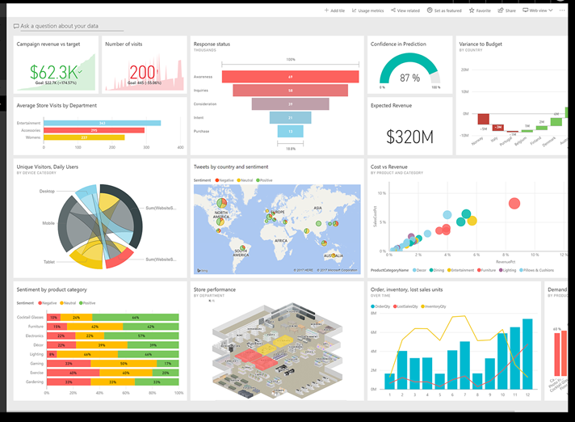
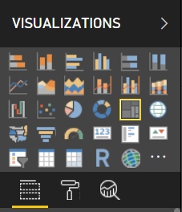
Creating and Formatting Visuals in Power BI
In this section, we focus on beautifying our generated visuals with various formatting techniques.
We also discuss one of Power BI’s most powerful capabilities - data filtering.
Filters
Introduction to filters in Power BI
How to set-up filters in Power BI
Types of Visuals
We will dive into the following types of visuals in Power BI:
Filter
Table
Card
Line Chart
Column Chart
Bar Chart
Scatter Chart
Treemap
Formatting
Introduction to filtering visuals in Power BI. This includes:
Visual titles, color, fonts, size, position etc.
Rounding
Data labels

Slide 13
Overview of Power BI
Using Data in Power BI
A Framework for Producing World-Class Visuals
Data Manipulation and Data Engineering in Power BI
Creating and Formatting Visuals in Power BI
Dashboarding Best Practise

Slide 14
Dashboarding Best Practise
In this section we review:
Ways to keep visuals relevant to your audience
1
2
We provide visual examples to clearly draw contrast between the mentioned do’s and don’ts of dashboard building.
Ways to group relevant data
3
How not to clutter visuals and reports
4
How to avoid overlaying graphs
5
How to correctly format a report

